Slide 1

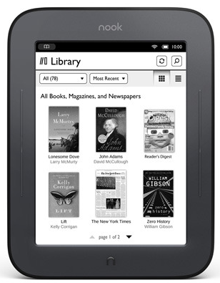
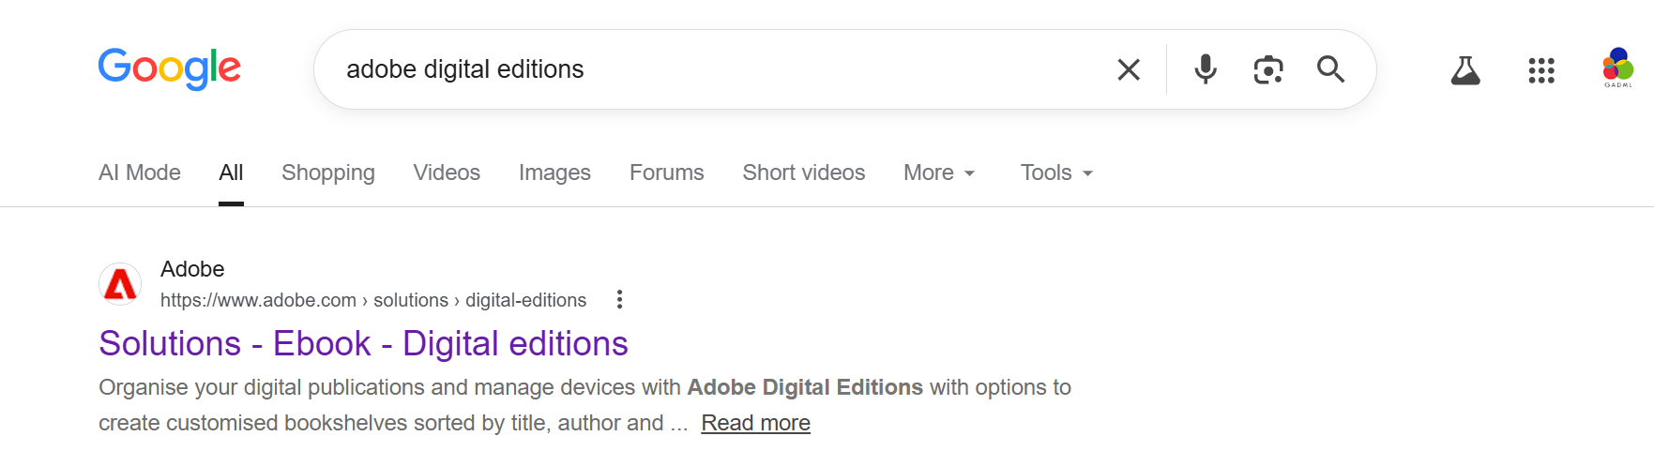
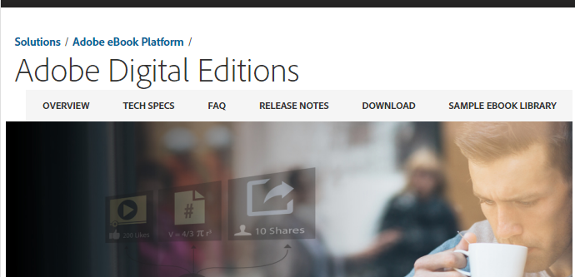
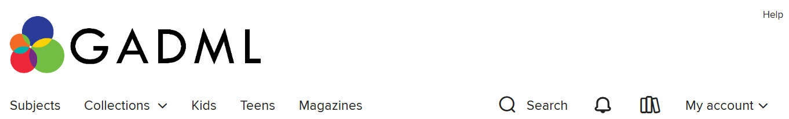
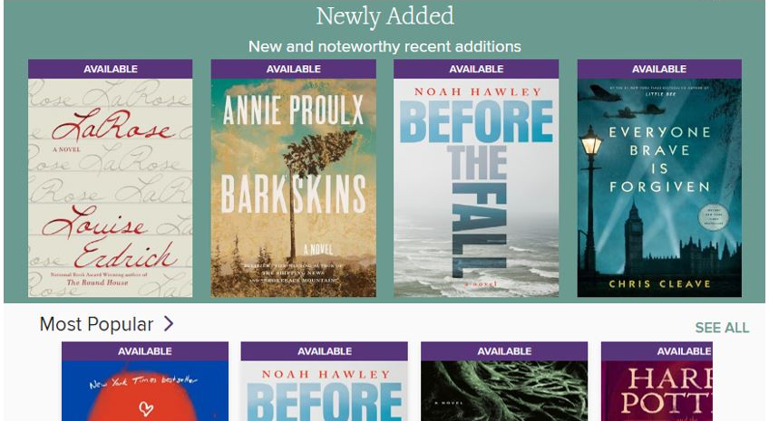

Library eBooks For ePub eReaders
Some versions of Nook, Sony, Kobo, and other EPUB readers
Step One: Download Adobe Digital Editions Software
(you only need to do this once per computer)
Search for Adobe Digital Editions
Click “Download” to begin.
Follow the installation instructions.
-You will be prompted to authorize
your computer with an Adobe ID. If
you don’t already have one, you can follow the link to create a free account.
Step Two: Check out Library eBooks
Visit the OverDrive eBook Catalog webpage:
midland-mi.overdrive.com
Browse or Search for a title
Your borrowed items
Search
Browse
Click See All to see the rest of the featured lists

Slide 2
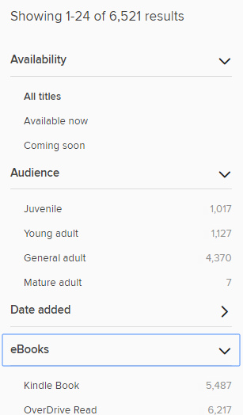
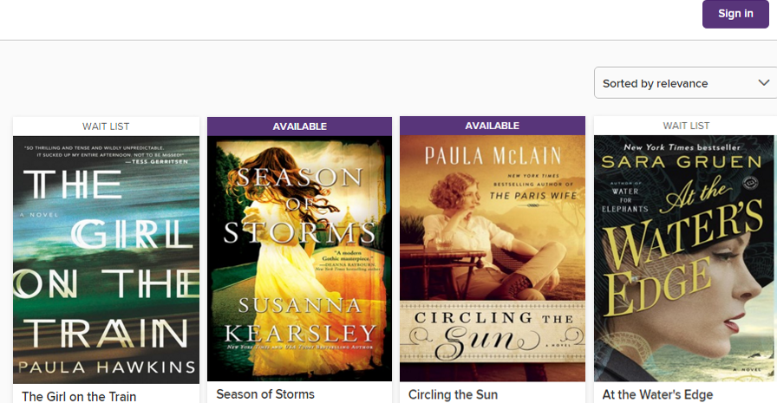

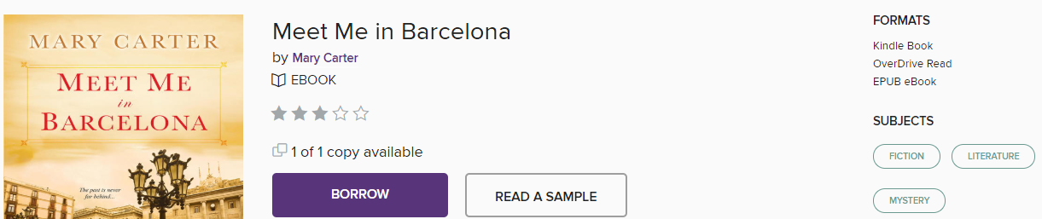

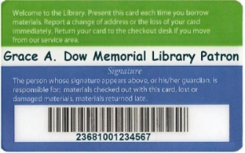
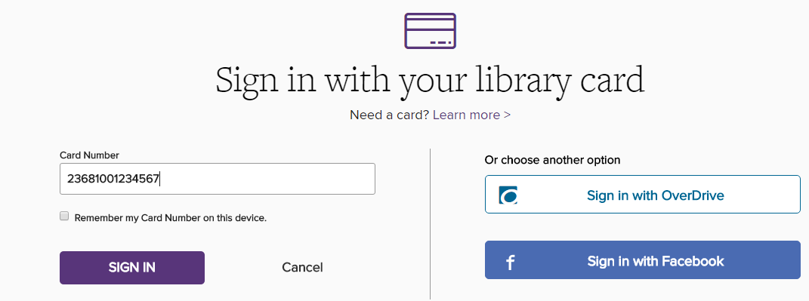
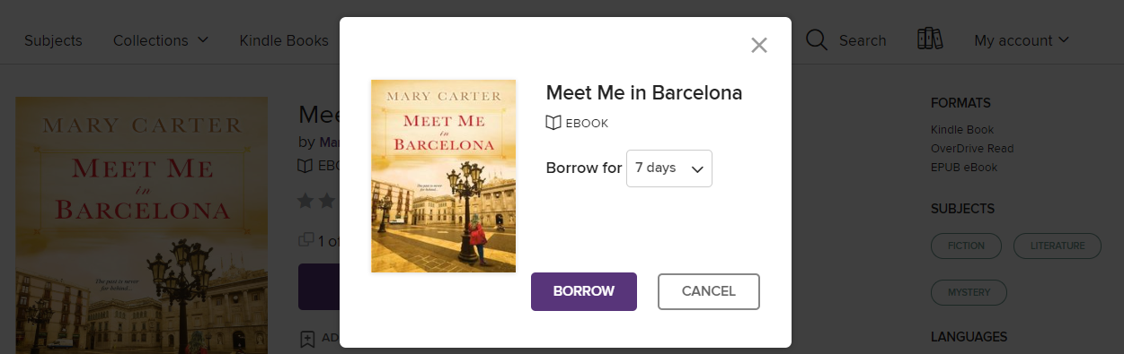
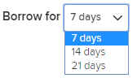

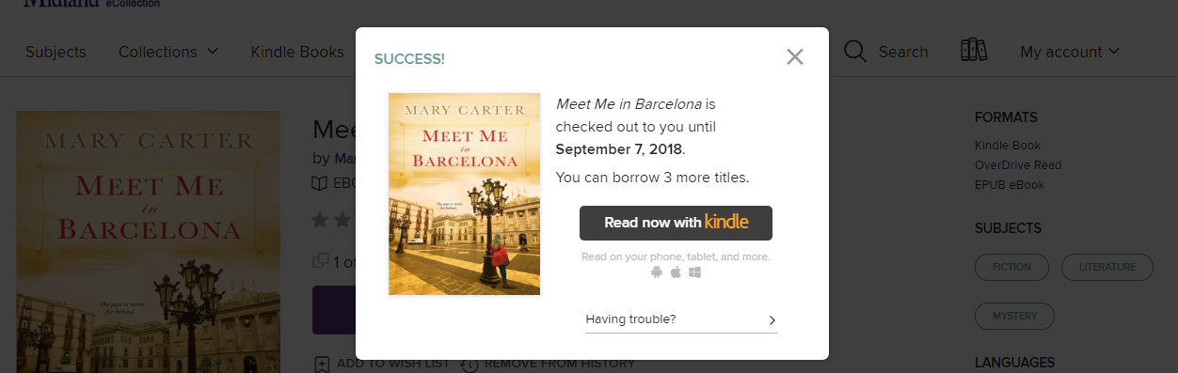
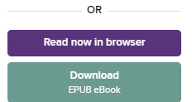
Organize and view
If you do not see these side options, choose Filters.
To show items you
can have now, click
Available Now
Wait List - Item is checked out
Available – You can borrow now
Click Audience to limit by age
Sort the list:
Date added
Popularity
Release Date
Title
Author
Click cover to view the item
Check out the item
Look for EPUB in Formats
Click Borrow
If you see the item is checked out and unavailable. Click to enter your library card as well as an email and you will be notified when it is available.
Sign in with your library card number
Enter the entire number, no spaces
Borrow and choose to download
Choose how long to borrow the title and choose Borrow
Click here to go to your loans
Click Download EPUB eBook

Slide 3
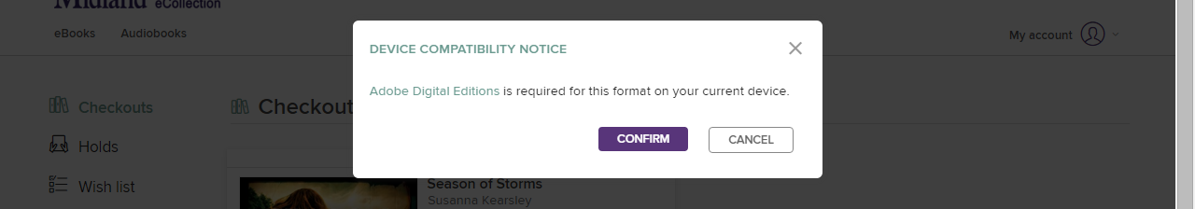
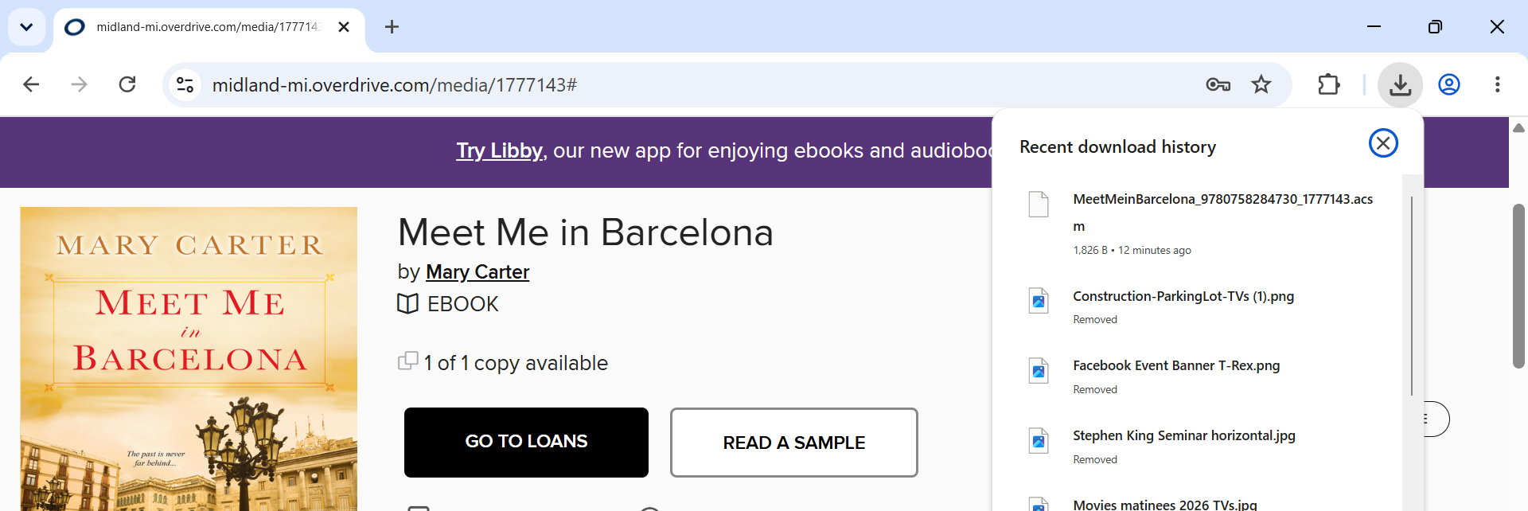
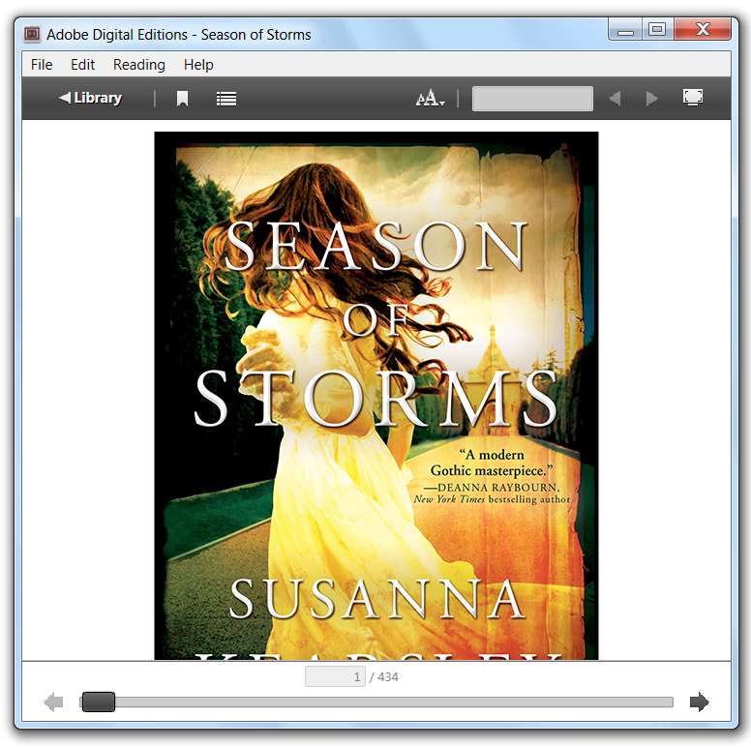

Click Confirm
A file will download to your computer, find and click to open the eBook and if you have installed Adobe Digital Editions, the book will open in the software.
Click Library
to go to the library view

Slide 4
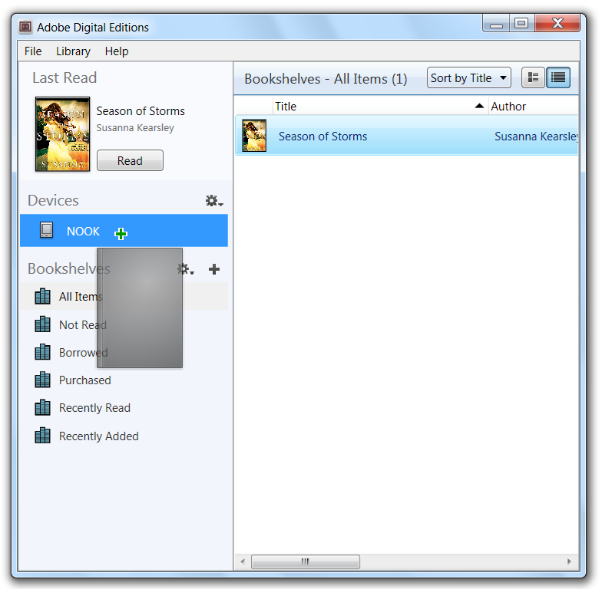
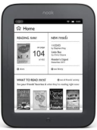
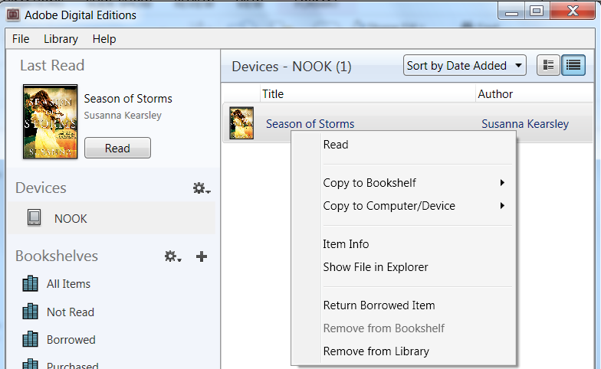
Plug the Nook into your computer using its cable.
Click All Items under Bookshelves.
Drag the title over your eReader’s name and when you see the green drop the eBook to send to your device.
On your Nook
Look for the borrowed eBook in “Library” then
“My Files” and for some versions of the Nook look in the folder called
“Digital Editions.”
Return your eBook before the due date
On your computer, launch Adobe Digital Editions.
(No need to connect your device)
In the Library View:
Right click your mouse while hovering over the book. (or control-click for Mac)
Select Return Borrowed Item.
Delete the title on your device
Right click and choose Return Borrowed Item

